Slide 1
Welcome To Our Presentation

Slide 2
Group Members
1.
2.
Name : Md. Samiul Islam Sahin
Id : 13334329
Dept : CSE
Name : Rahul Basak Santo
Id : 163432532
Dept : CSE

Slide 3
OUR TOPIC ON
Micro-Finance Banking & Loan Software

Slide 4

Concept About Micro-Finance
What is Micro-Finance :
Microfinance also called MicroCredit, is a type of banking service that is provided to unemployed or low-income individuals or groups who otherwise would have no other access to financial services.

Slide 5
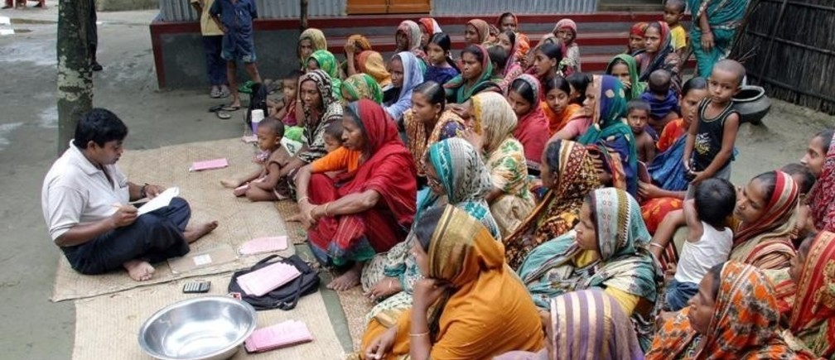
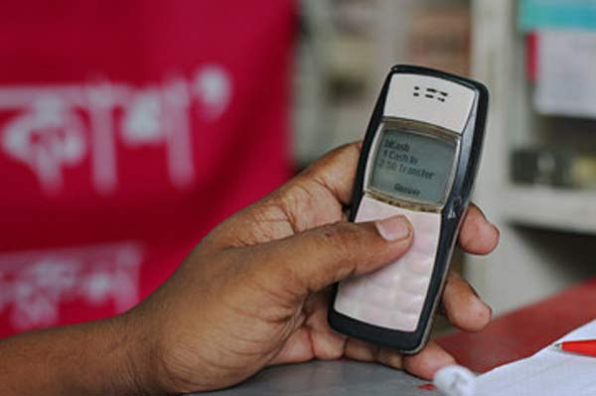
Change After Using Software
Present Situation
Future Situation

Slide 6
Our Software Work Purposes
1.User Can Take Loan
2. User Can Deposit Their Money
3. Can Give Their installment using Mobile Banking ,Cash Or Bank
4. They Can Withdraw Their Money Via Bank,M-Banking or Cash.
5. User will Get SMS When Their installment Date come To close.
6. One User Can Transfer To Another User (Charge Appilcable).
7 . Admin Will Get All Report About , total Withdraw , Deposit, Taking Loan, User Balance etc.

Slide 7
Create User
Waiting For Approved
No
Deduct Yearly Charge From Account
Approved
Withdraw
Deposit
Cash
Take a Loan
Bank
Installment
Complete Installment
Exit
Mbank

Slide 8
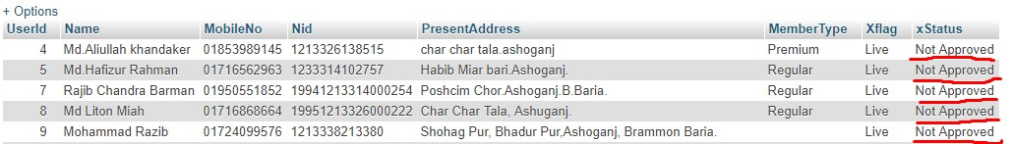
Software Operation
Create a User Information its waiting For Approved

Slide 9
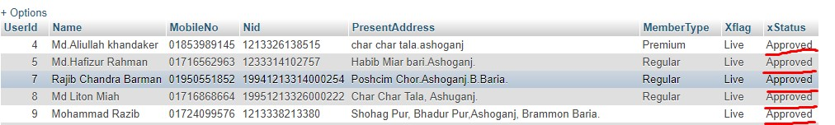
Software Operation
After Giving Approved by Admin

Slide 10
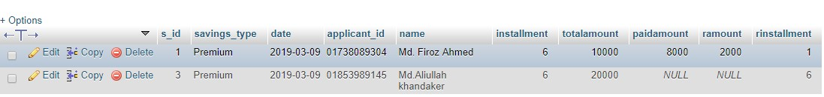
Software Operation
Here Some Data Who Open an savings Account,Frist Person who Open 10,000 tk savings account and paid 8000 tk but another person who open an account but did not pay yet, here we can see remaining balance and installment also

Slide 11

Software Operation (Loan Permission)
Two person open an Savings Account But One Person are allowed to take a loan because only one person deposited minimum balance and he/ she will get only 3 times of his/her balance

Slide 12
Software Operation (Loan Entry)
Here is some information who apply for a loan (Only Deposited Person are allowed to apply for a loan)

Slide 13

Software Operation
After apply for a loan he/ she can not apply further for another loan, after pay this loan amount then he / she can apply another loan, Loan running session he/she can not withdraw their deposited amount.

Slide 14
Software Operation (Loan Status View)
After Paid one or more installment here we can see that Due Amount , paid amount and remaining installment also

Slide 15


Software Operation (withdraw)
If someone withdraw from their account available balance this amount will be deduct from their account
Before Withdraw
After
Withdraw

Slide 16
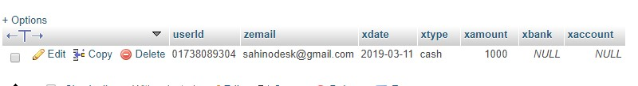

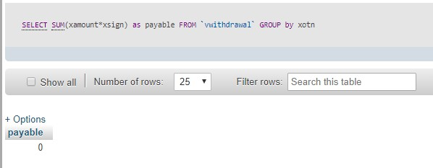
Software Operation (withdrawal paid)
After Paid withdrawal amount it will show as like bellow pictures, that why they can not pay again and again

Slide 17
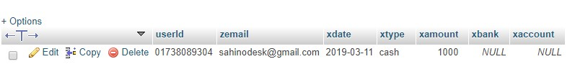
Today Withdrawal Paid Report
This is withdrawal Paid report date to date

Slide 18

Loan paid installment Report
How many people deposit amount as their loan installment, it will show according to date to date

Slide 19
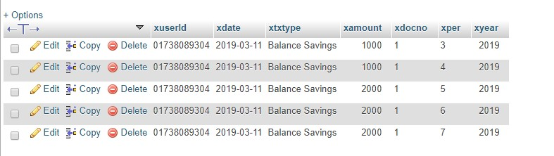
Savings Deposit Report
How many People Deposit Their Money as savings account it will show those type of report

Slide 20

Transfer charge Report
This report will show how many people transfer internal transection and this report is transfer charge report

Slide 21
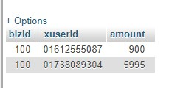
User Balance Report

Slide 22
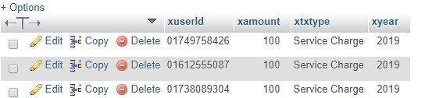
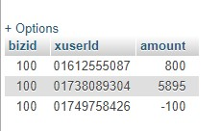
Yearly Service Charge
Service Charge Report
Current Balance

Slide 23
Similar Software In Market Place
CoBIS Microfinance Software
2. Sab Microfinance Software
3. MIS Microfinance Software
In Our Country Some Software Company Are Giving Micro Finance Software:
Data Soft System Bangladesh Limited
Brain Station Software Company Limited ,etc.

Slide 24
Difference From Others Similar Software
They don’t take their money from user via mobile banking or Bank. They Collect Their installment Manually Via Cash by using Android phone or Laptop (They just Entry Their Software Those transection Record)
They Can not Transfer Money From User To User (Internal Transfer)

Slide 25


Slide 26


